Slide 1
Samsung
Innovation
Campus
Introduction – Coding and Programming

Slide 2

Mr. Sandip Shriram Bapat
Brief about Sandip’s credentials
Dr. Sandip Bapat has over 20 years of Academic & Industrial R&D experience in the areas of Embedded Systems, Wireless Sensor Networks, IoT & Intelligent Voice Assistants
Education: Ph.D in Computer Science & Engineering
The Ohio State University, Columbus, OH USA (2006)
Sandip’s role in Samsung involves leading the Speech AI team to investigate State of the Art Signal Processing & Deep Learning based solutions for Speech Processing, Keyword Detection, Speech Recognition (ASR) & Speech Synthesis (TTS)
Part Leader, Speech AI
Samsung Research India, Bangalore

Slide 3
Samsung Innovation Campus (SIC) - Coding & Programming (C&P)
Train Students in Coding Skills
(Cultivate Logical thinking and Problem-solving ability based on computational thinking)
Vision
Higher Employability of Students
Mission
C&P Module:
Focussed on Python lang and basic DS/Algo
Serves as base for AI/ML, BigData, IOT modules of SIC
Typical Hiring Process (Samsung, others)
Step-1
Coding Test
Step-2
Coding Interview
Step-3
Tech Interview
Programing Basic Concept and Starting Python
Chapter 1
Chapter 2
Python Programing Basic
SIC
Chapter 3
Effective Python Programming
AI&ML
[Theory 270 Hrs
+ proj 80 hrs]
Big-Data
[Theory 160 Hrs
+ proj 80 hrs]
IOT
[Theory 160 Hrs
+ proj 80 hrs]
Chapter 4
Algorithm I: Data Structure
Chapter 5
Algorithm II: Sorting Algorithms
Chapter 6
Algorithm III: Problem Solving with Algorithms
Coding & Programing (C&P)
[~90 Hrs]
Chapter 7
Data Processing and Descriptive Statistics, Data Visualization
Chapter 8
Data Analysis and Visualization
(+ Mini Project)

Slide 4






Benefits of Coding & Programming
Technological Disruption
Post Covid-19, many jobs are redefined
Students skilled with Coding have a competitive advantage
Future Ready Career Skills
Coding skills will provide a basis of knowledge that can help strengthen their career prospects
Enhances Employability
High Income Potential
Programmers and developers are in high demand all over the world
Companies are willing to provide attractive benefits.
Additional Skills
Helps in Problem Solving skills
Solving problems in a logical and creative manner
Wide Scope
Apart from Software many job roles require Coding
Business Analysts, Data Science etc are emerging fields

Slide 5
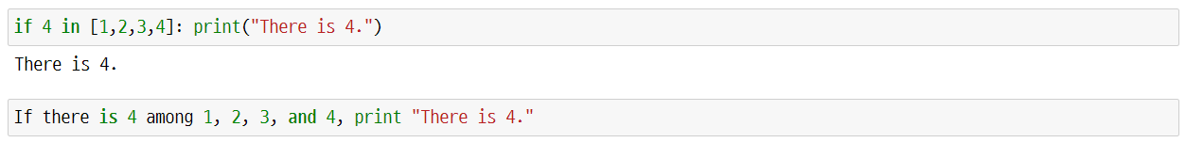
Python Language – A Glimpse
<Most loved languages in 2020>
What is Python used for?
Python
Artificial Intelligence
&
Machine Learning
Data Science
&
Data Visualization
Web Development
Game Development
Automation
Software Testing and Prototyping
Simplifying everyday tasks
through automation
https://insights.stackoverflow.com/survey/2020
Written and interpreted similarly as human’s everyday language
Python syntax
Interpreted

Slide 6
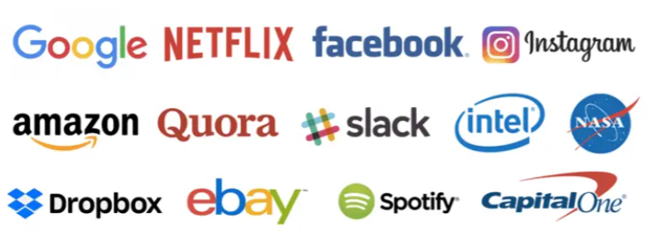
Why is Python so popular?
Why is Python so popular?
Educational fields
Professional workplaces.
Major companies that use Python
Google to enhance its search engine capabilities.
Netflix to recommend movies, TV shows
Instagram to personalize the explore section for users.
Spotify for personalized music recommendation
Reddit for web development to simplify the Q&A sections.
<Major companies that use Python>
https://www.botreetechnologies.com/blog/pros-and-cons-of-python/

Slide 7
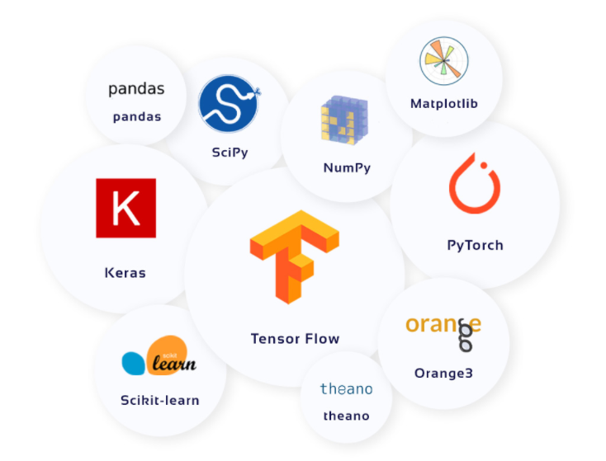
Why is Python so popular?
Why is Python so popular?
Many industries use Python as it offers open-source libraries that contain built-in modules.
Python includes various libraries such as pandas, NumPy, SciPy, Matplotlib, TensorFlow, and Keras,
Extensively used in different fields like web development, data analytics, and artificial intelligence.
Major companies that use Python
<Python libraries>
Pandas
Used for data manipulation and analysis
Particularly featuring numerical tables and time series operation.
NumPy
Supports for large, multi-dimensional arrays and matrices,
Collection of high-level mathematical functions.
TensorFlow
Based on dataflow and differential programming,
Focuses on deep neural networks for machine learning.
Keras
Provides an interface for artificial neural networks
Focus on enabling fast experimentation.
https://light-it.net/blog/top-10-python-libraries-for-machine-learning/
Notes:
1. Readable code can be written in Python
2. The large developer base (Stack overflow)
3. Low development / build time : Quick and handy for a quick PoC development.
4. Application of python (5~7 different fields) (webscraping, ML, web backend
5. Career (9~12 lakhs for a fresher)

Slide 8
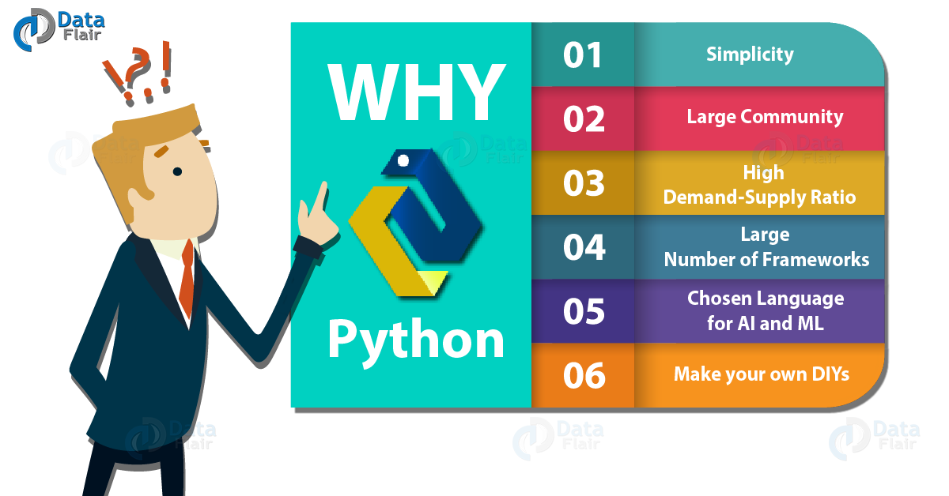
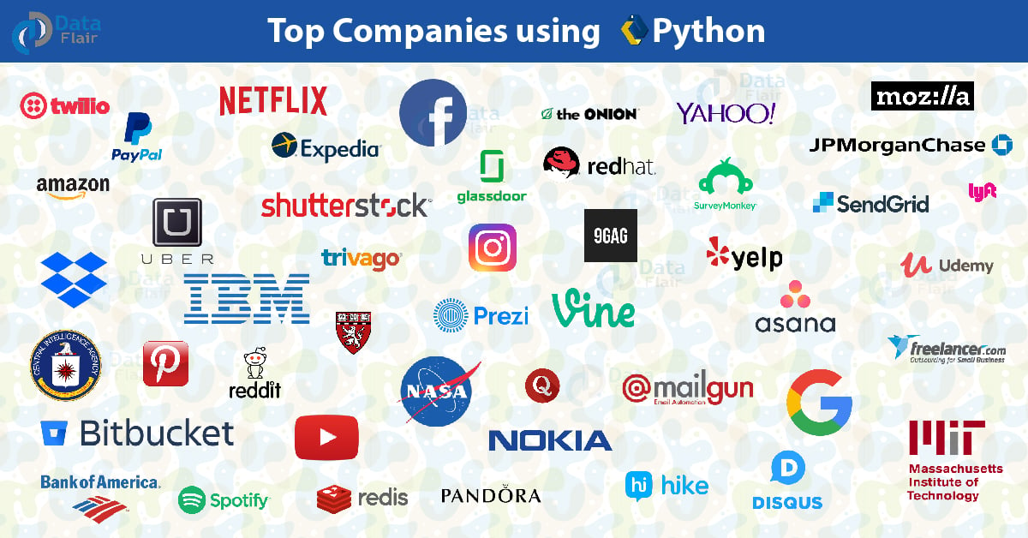
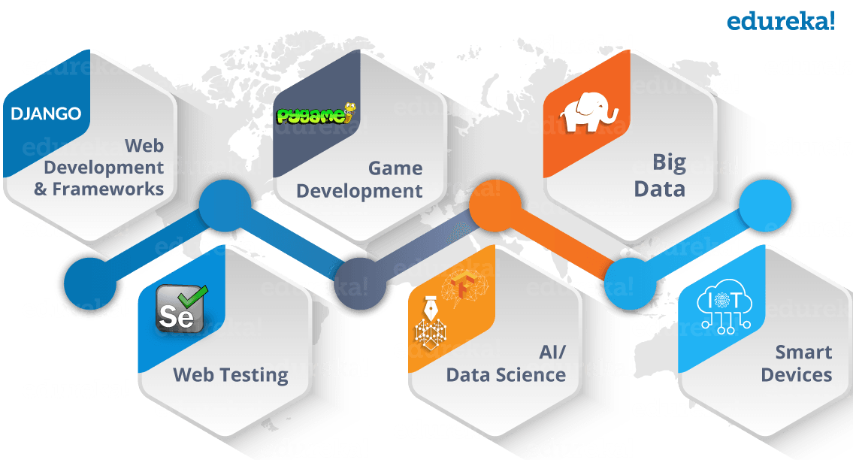
Python Career Opportunities
Python Job Profiles
Software Engineer
Python Developer
Research Analyst
Data Analyst
Data Scientist
Software Developer
Python is finding its application in diverse domains, as illustrated below

Slide 9




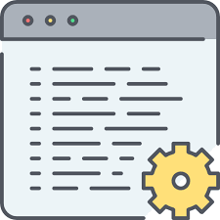

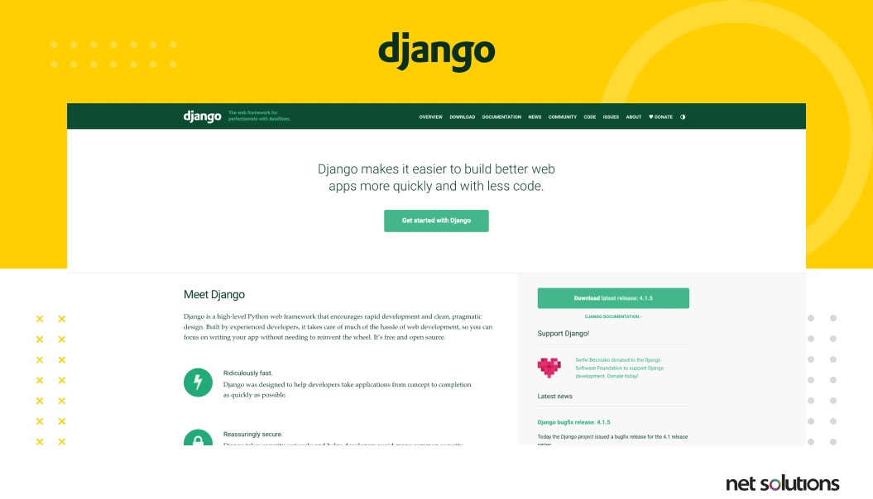
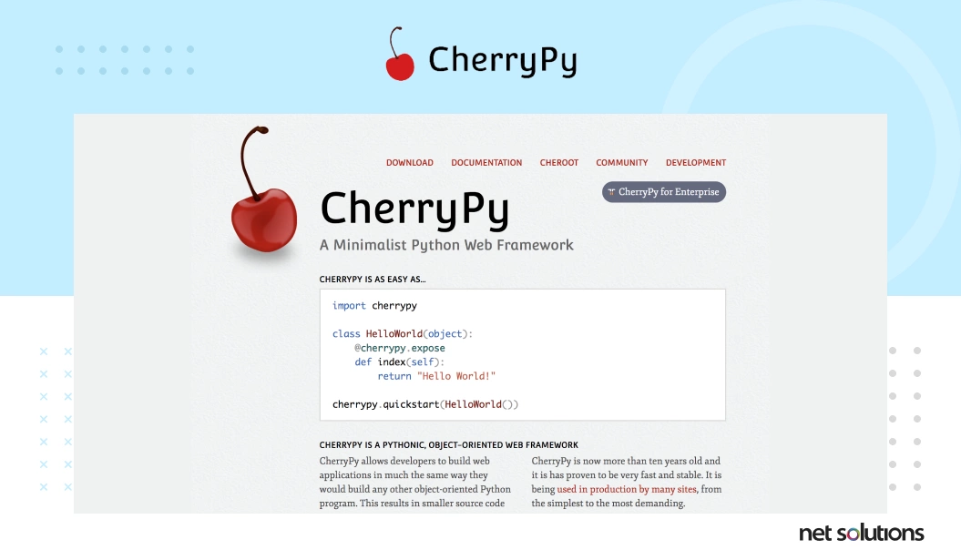
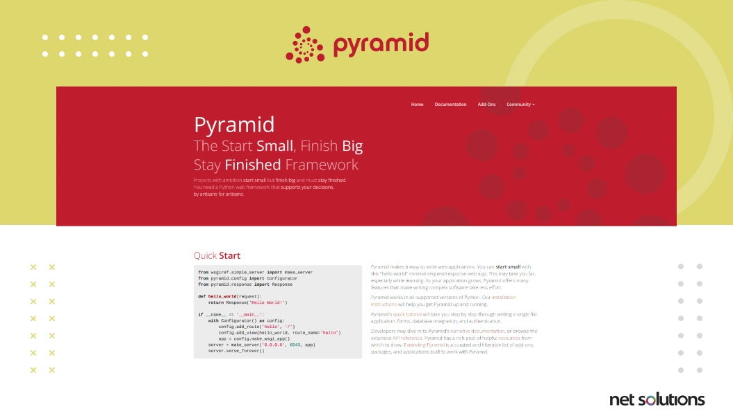
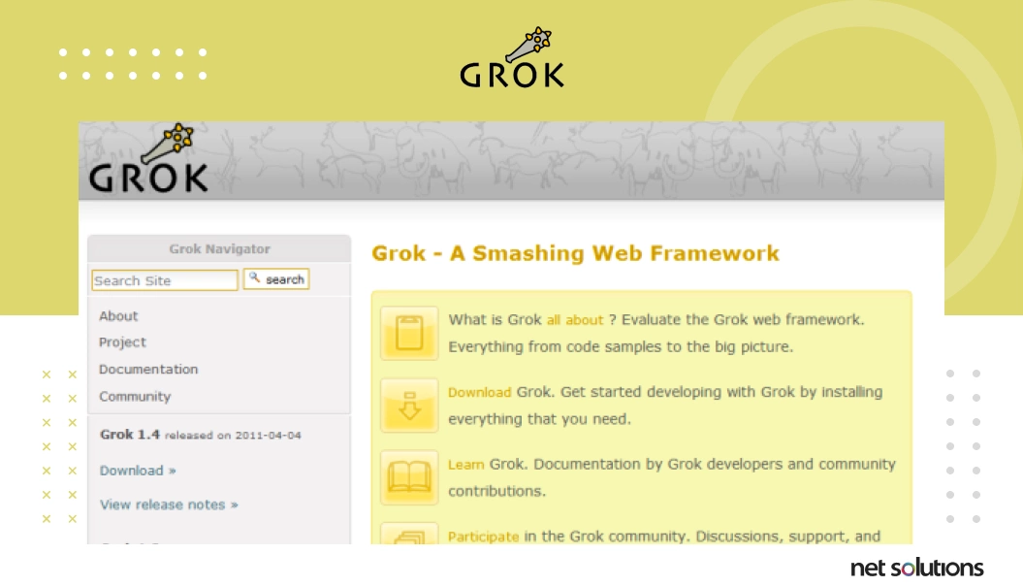
Python For Web Development
Python Websites
Youtube
Instagram
Spotify
Dropbox
Pintrest
Frontend
Backend
React
Angular
VUE
DJANGO
ASP.NET Core
Python frameworks for web development

Slide 10





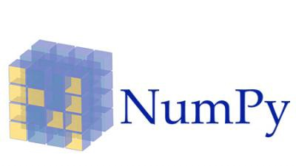
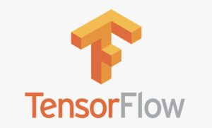



Python For Machine Learning
Companies using Python for ML
Google
Meta
Netflix
Amazon
Uber
Python libraries used for ML

